Slide 1

RMN Auto Sales
By: Shiv Bhagat, AJ Albrecht, Nicholas Ayson

Slide 2
Project Description
RMN Auto Sales is a company that needs data to be stored. This dealer purchases cars that most likely need repairs from different places and refurbishes them to be sold back to consumers. The companies responsible for repairing these cars and to record how much these repairs cost and all the other information about the car. The car will also come with the option of Warranty, so the dealership has the option to sell that to the customer as well. Then when they will resell the car they will record the customer’s information as well as the sale that pair with the customer and contains the amount that was paid to the company. They also need a way to store information about the payments that have occurred as time passes. So our duty is to make a database that allows the employees to make changes to the database and store all of this information.

Slide 3
System Architecture
Software:
Back End: Microsoft SQL Server Manager
Front End: Blazer (with radzen and visual studios)
Languages Used: SQL and C#
Hardware - Server
CPU: I5 10400f
Memory: 12gb ddr4
Disk Space: 250gb ssd
Operating System: windows 10
Hardware - Clients:
I3 4030u
6gb ddr3
700gb Hard Disk
Windows 8
Ryzen 5 3600x
16gb ddr4
1tb ssd
Windows 10

Slide 4
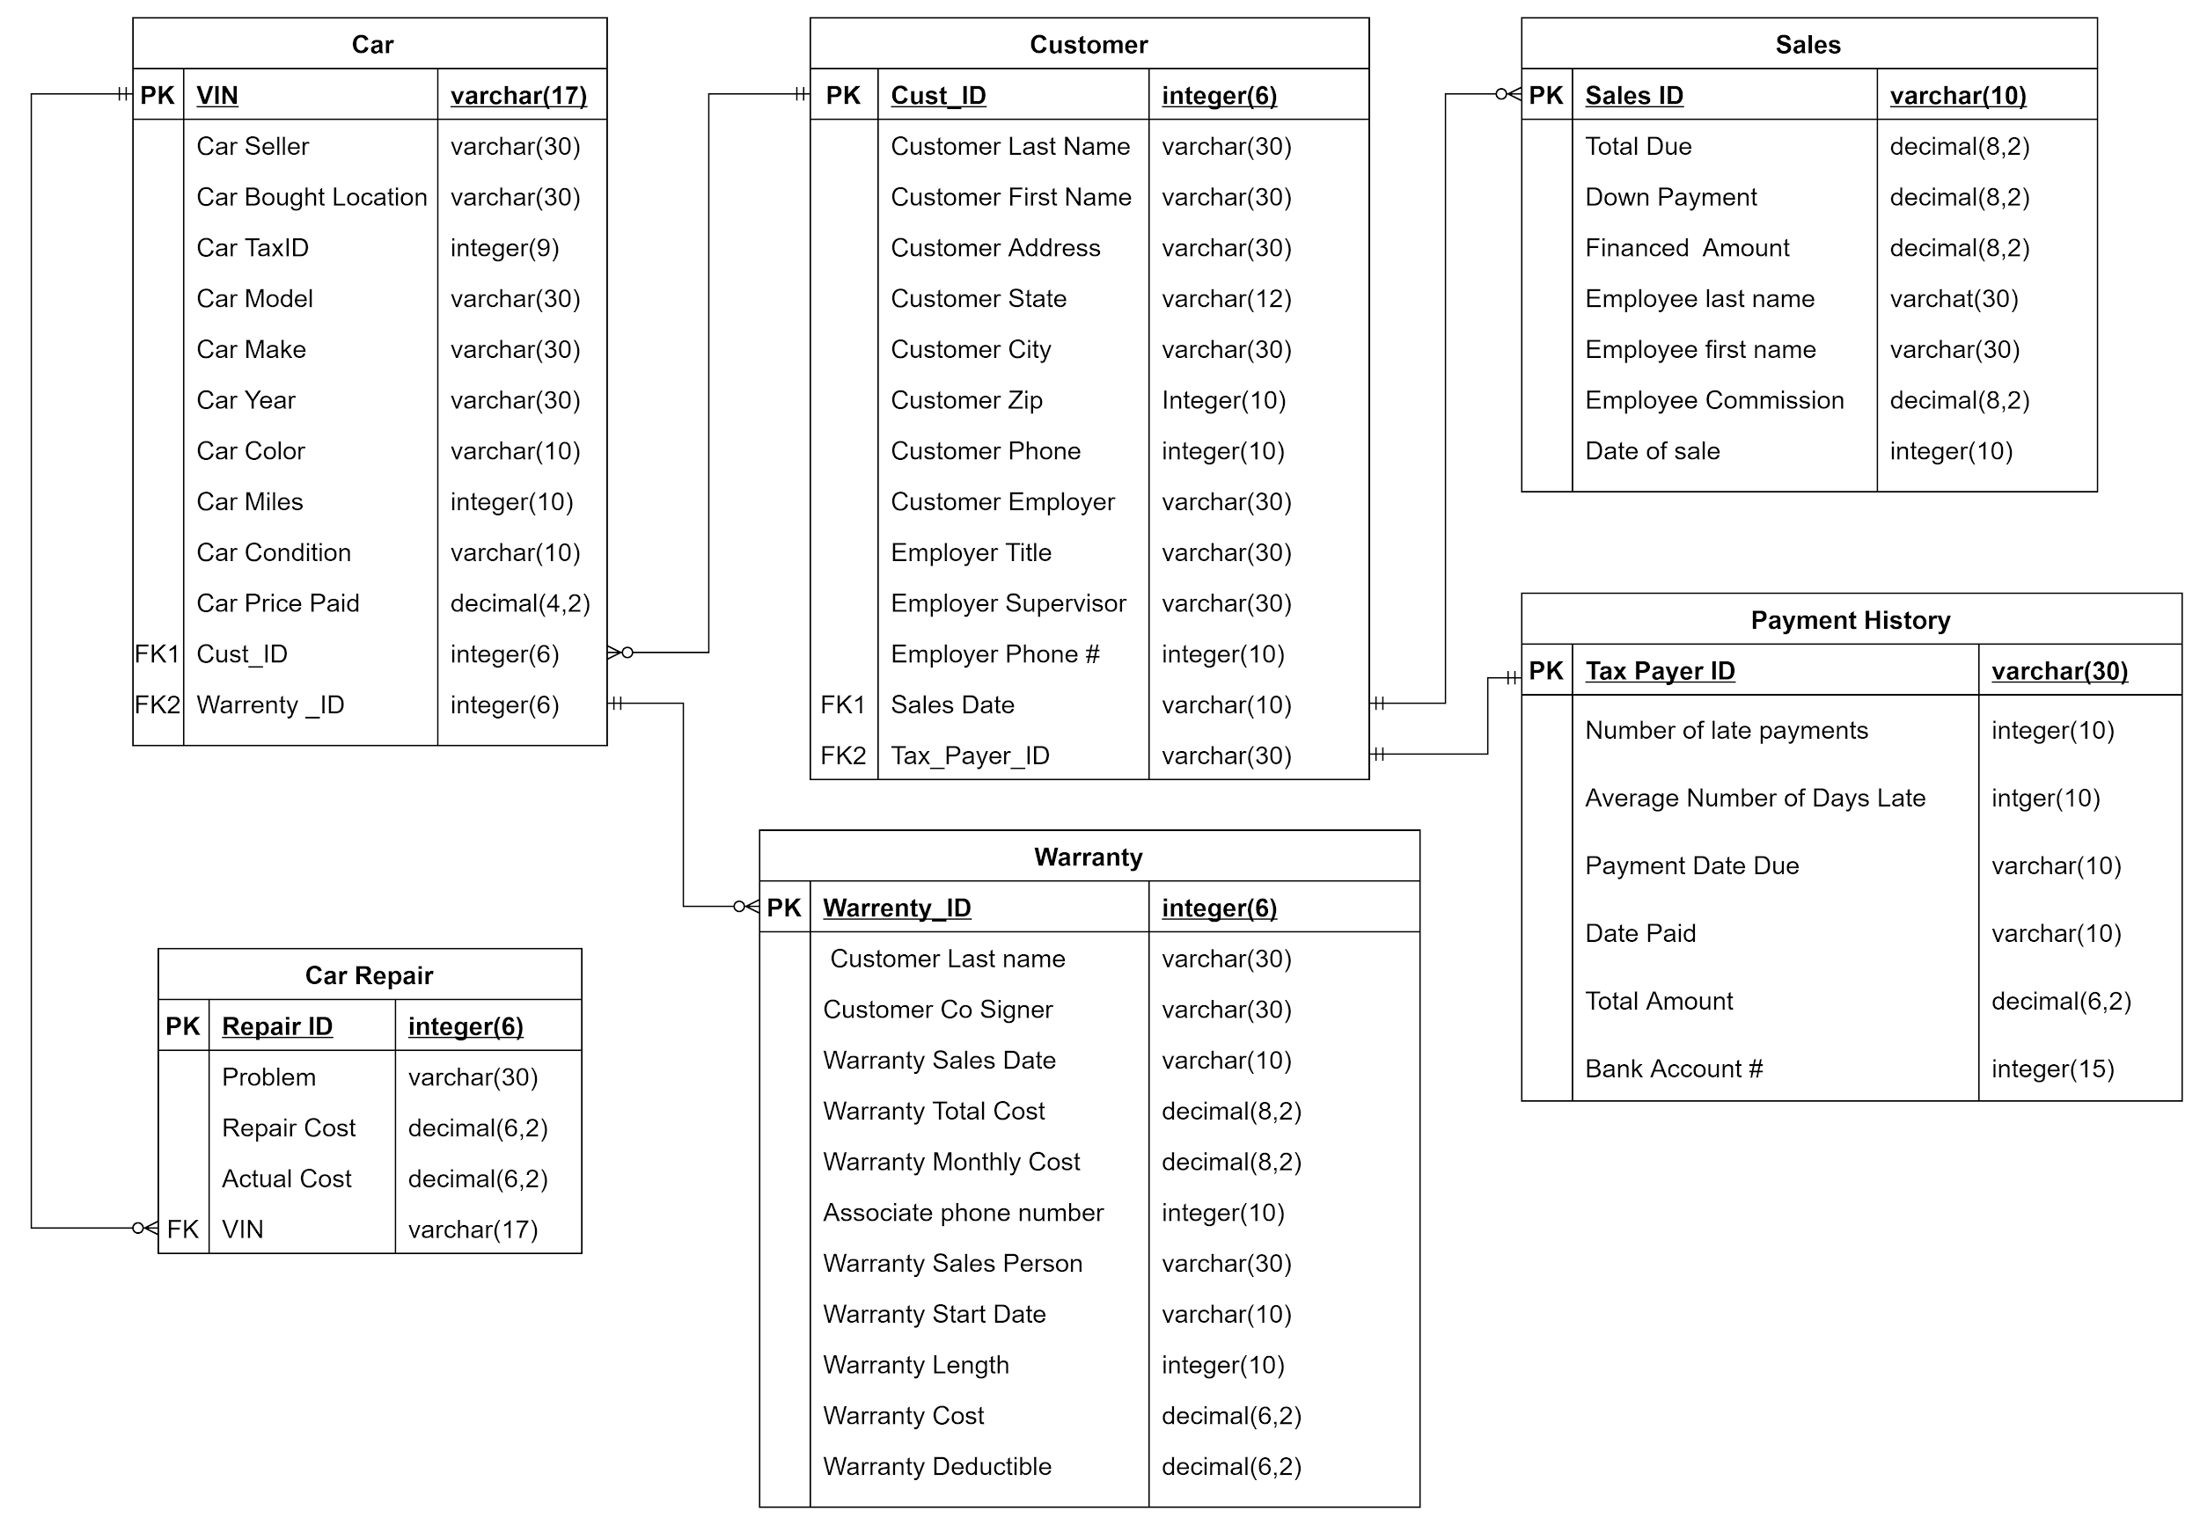
Data Model Summary
Our transactions are centered around the car. As soon as the store gets a car, it is entered in the database. Once a car is repaired, it can be matched to a customer who buys the car. Their payment information is tracked through sales payment history. In addition, a customer can add zero to many warranties on their purchase, which is reflected in the warranties table.

Slide 5
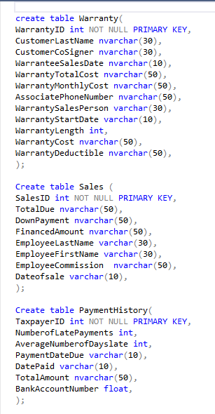
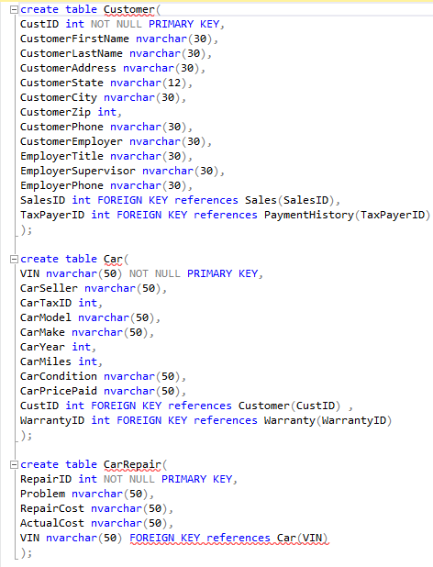
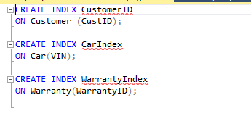
Database and Tables Creation DDLs

Slide 6
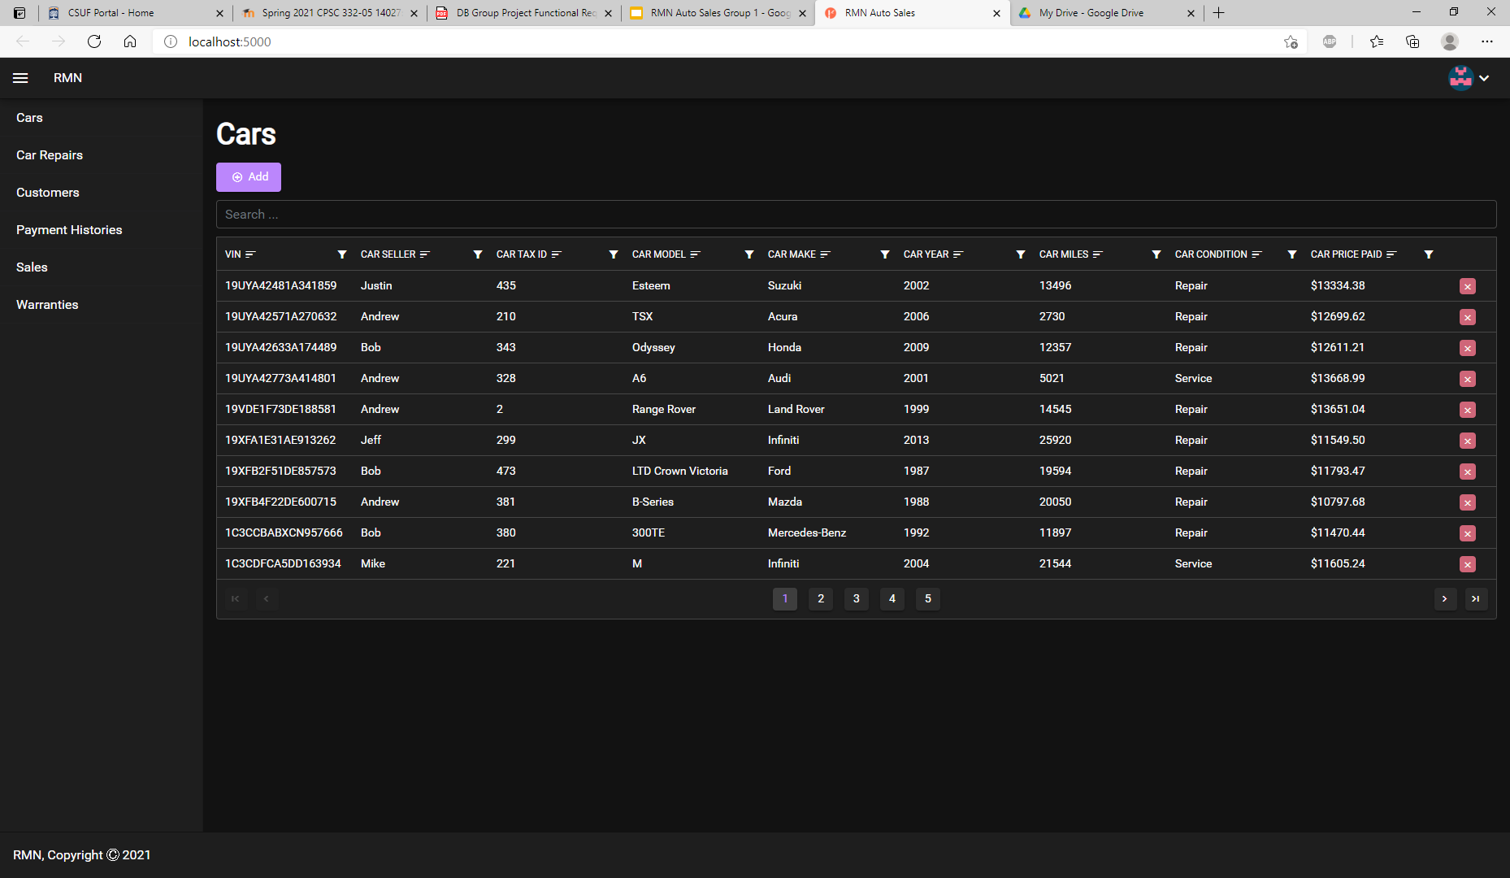
Application UI

Slide 7
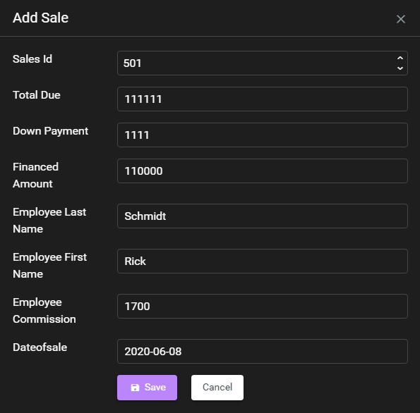
Application functions
CRUD functions
Create-

Slide 8
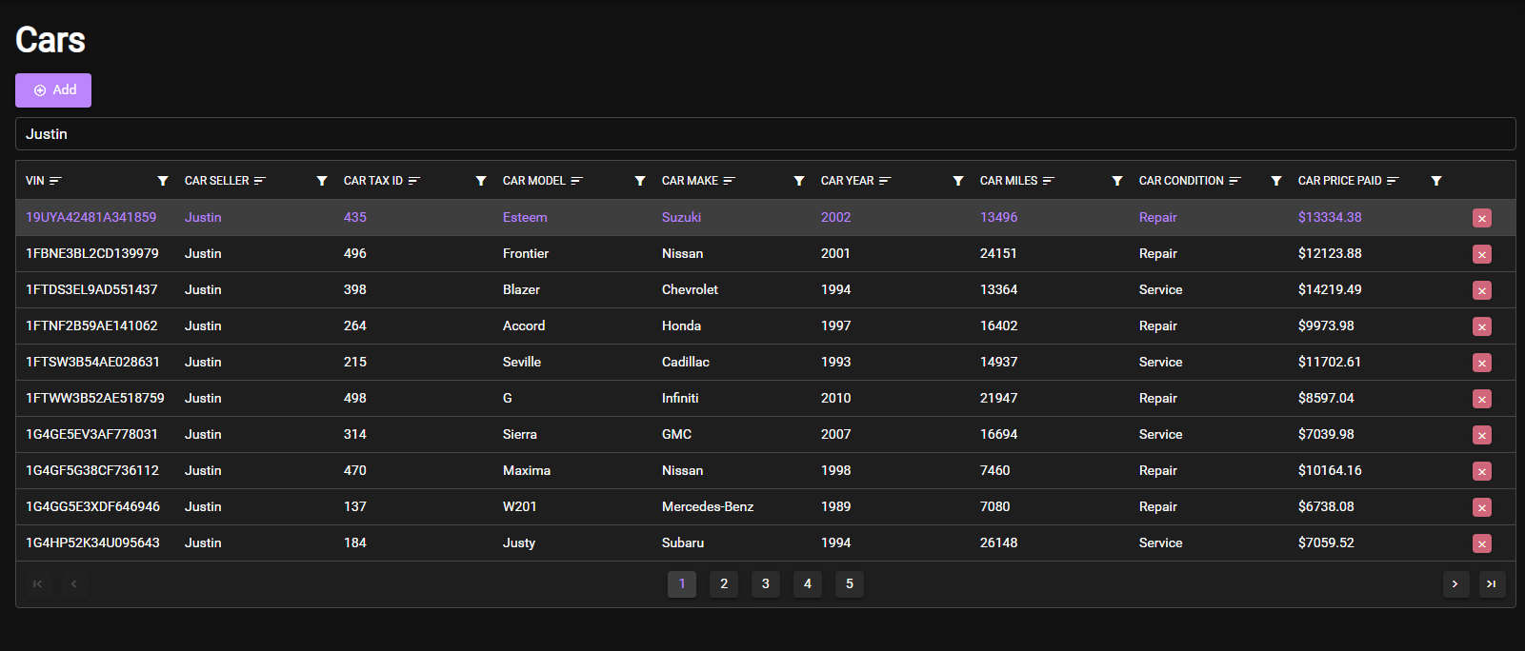
Read
Read from database -

Slide 9
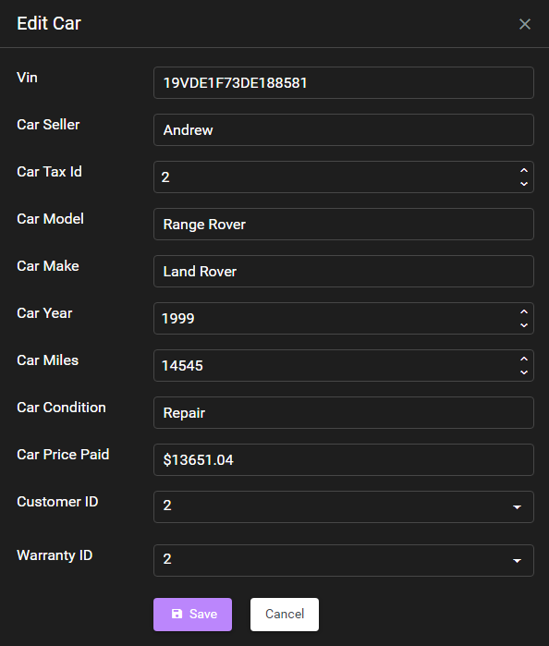
Update
Update-

Slide 10
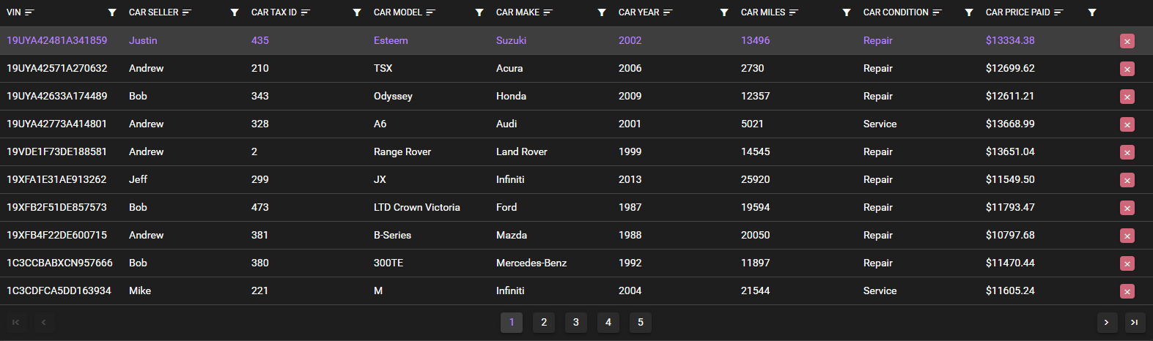
Delete
Delete click the x next to row-

Slide 11
System Reports
Output of create:
After deleting the entry:

Slide 12
Live Demonstration
We will now demonstrate our database.

Slide 13
Significance
Overall, this project was important in helping us gain experience in designing frontend and backend of database. None of us had experience with databases or any database languages beforehand. Now that we have more experience, we should be able to create more complex databases in the future.

Slide 14
Lesson Learned
Overall, we learned that setting up a database takes a lot of time and planing. We end up spending more time than we had originally planned. In addition, we also learned just how important modeling the data ahead of time was. We end up going through several data models before we arrived at the version we used in our implementation. (Including going from 11 tables to 6). Implementing a web application with our sql server takes a lot of time of research and planning.

Slide 15
Improvements
To allow for better user navigation, we could have added a tutorial to guide users on how to create an entry.
Users currently do not know if someone else has modified data unless they changed a page. To prevent potential conflicts, we could make it so that other users are notified when a someone modifies the database.

Slide 16
Potential Uses
The software that was built can be useful for small businesses. The software should be able to reliably sort and look around a few thousand entries. However the software is only designed to support a single location. To support additional locations and separation of data, the software would need to be modified.

